Slide 1
HTML TAGS UNIT: LINKS
MCNDHS
Ms. Eng

Slide 2
AIM: LINKS TO E-MAIL, LINKS TO A NEW PAGE
Do now:
Grab a laptop!
Daily Grade:
On-time/attendance/not leaving the classroom: 25%
Cellphones: 25%
Notes:25%
Classwork/Homework: 25%

Slide 3
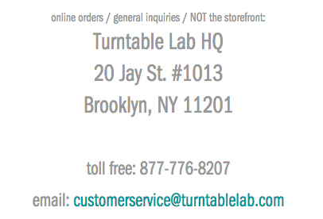
WHERE YOU SEE IT

Slide 4
TAG: E-MAIL
Opening tag:
<a href=“mailto:inserte-mailadress@email.org”>
write words here
Closing tag:
</a>

Slide 5
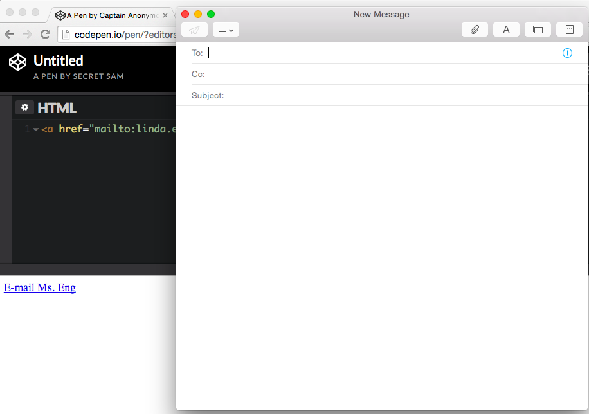

EXAMPLE:

Slide 6
OPENING LINKS IN A NEW WINDOW
Opening tag:
<a href=“insert the link of the webpage” target=“_blank”>
ADD WORDS HERE THAT DESCRIBE YOUR LINK
Closing tag:
</a>

Slide 7
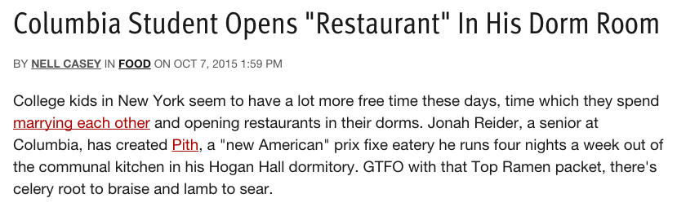

EXAMPLE:
critical thinking: why is it important?

Slide 8
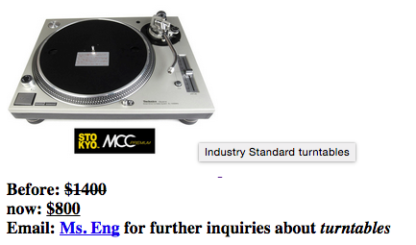
ACTIVITY
Rules:
1) Make the image a link that opens up in a new tab
2) Create a box that appears when you hover
3) Create a before price and after price
4) Create an e-mail link.

